Slide 1
Investment Portfolio Optimisation
MIS775 – Decision Modelling for Business Analytics
Student Name: Mehdi Tavakoli
Student ID: s224304485
Trimester: T1 2025
Deakin University

Slide 2
Introduction
This report presents an investment portfolio optimisation project using real-world data from the Australian Stock Exchange (ASX).
The primary objective was to determine the best combination of eight assets across four different industry sectors, maximising returns while considering risk and diversification constraints.
Two modelling approaches were applied:
Linear Programming (LP): to determine optimal weight allocations
Integer Linear Programming (ILP): to select the best combination of exactly 5 stocks
Microsoft Excel Solver was used to implement and solve both models, supported by sensitivity analysis(LP Model) to evaluate solution robustness.

Slide 3
Stock Selection and Data
Selected Investments:
Given: Pro Medicus (S11), Xero (S21), Telstra (S31), Commonwealth Bank (S41).
Chosen: Telix Pharmaceuticals (S12), Cosol (S22), SEEK (S32), ZIP (S42).
Sectors: Health Care (S1), Technology (S2), Communication Services (S3), Financials (S4).
Stock
Sector
Risk Group
Avg. Return
Std Dev
Pro Medicus (S11)
Health Care (S1)
R2
0.04553
0.1094
Telix Pharm (S12)
Health Care (S1)
R3
0.0564
0.177
Xero (S21)
Technology (S2)
R2
0.0116
0.0942
Cosol (S22)
Technology (S2)
R2
0.019
0.0802
Telstra (S31)
Comm. Services (S3)
R1
0.0055
0.0357
SEEK (S32)
Comm. Services (S3)
R2
-0.0007
0.0849
Comm. Bank (S41)
Financials (S4)
R1
0.0156
0.063
ZIP (S42)
Financials (S4)
R3
0.0205
0.3346

Slide 4
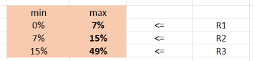
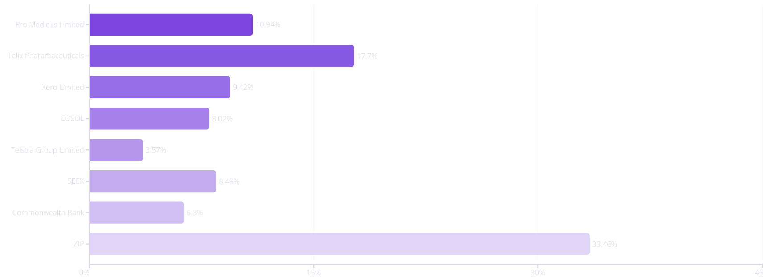
Risk Classification and Volatility
Wide range of volatilities (0.0357 to 0.3346) ensures risk diversity.

Slide 5

Linear Programming Model
Optimizing investment allocation across sectors to maximize returns while managing risk constraints

Slide 6
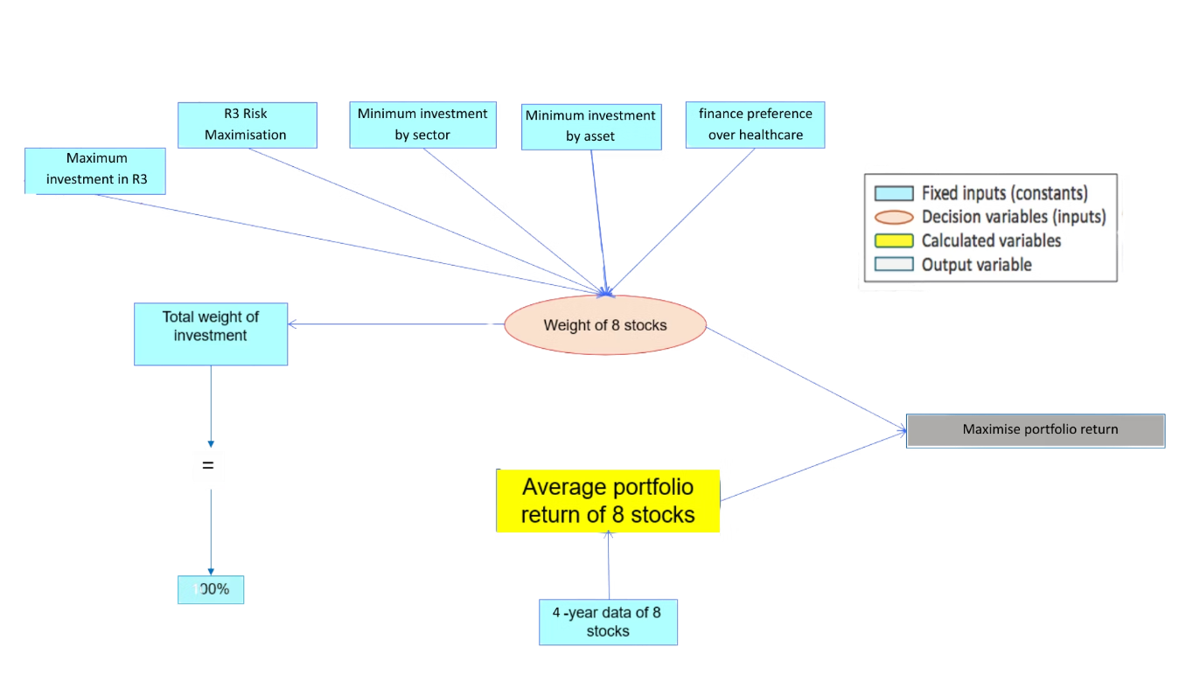
LP Model - Conceptual Diagram

Slide 7
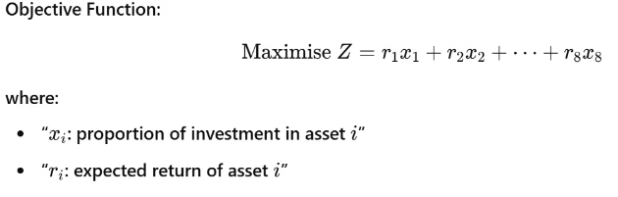
LP Model - Algebraic Formulation
Max Z=0.04553wS11+0.0564wS12+0.0116wS21+0.019wS22+0.0055wS31−0.0007wS32+0.0156wS41+0.0205wS42
Constraints
R1 has the highest allocation (wS31+wS41)≥(wS11+wS21+wS22+wS32), (wS31+wS41)≥(wS12+wS42)
Each sector (except one) ≥ 15%:
S1: wS11+wS12≥0.15
S2: wS21+wS22≥0.15
S4: wS41+wS42≥0.15
S3: wS31+wS32≥0.20
Minimum investment per stock: wi≥0.05 for all (i)
financial service more than Healthcare: S4 ≥ S1 (wS41+wS42)≥(wS11+wS12)
Sum of weights = 1 ∑I wi =1

Slide 8
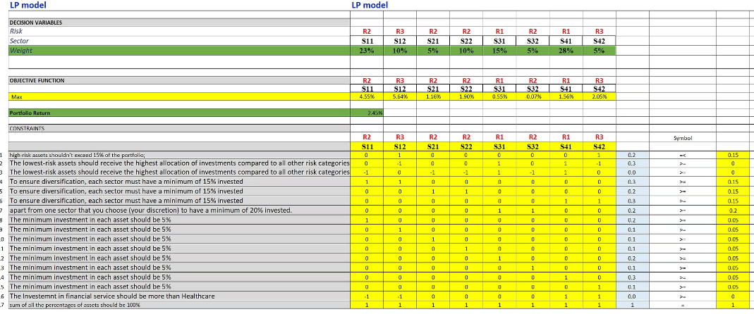
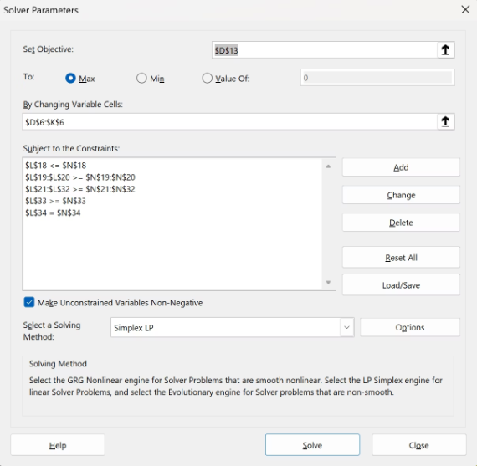
LP Model – Solver Configuration

Slide 9
Optimal Portfolio Allocation
Asset
Sector
Risk Group
Weight (%)
4-Year Return
Pro Medicus (PME)
Healthcare
R2
22.5%
4.55%
Telix (TLX)
Healthcare
R3
10.0%
5.64%
Xero (XRO)
Technology
R2
5.0%
1.16%
COSOL (COS)
Technology
R1
10.0%
1.90%
Telstra (TLS)
Comms
R1
15.0%
0.55%
SEEK (SEK)
Comms
R3
5.0%
-0.07%
CBA
Financials
R1
27.5%
1.56%
ZIP
Financials
R2
5.0%
2.05%
Total Expected Return: 2.45% Model met all constraints, including max R3 = 15%, R1 > R2 & R3, and minimums for each sector and asset.

Slide 10

Sensitivity Analysis
Exploring how changes in constraints and parameters impact our optimal portfolio allocation and expected returns.

Slide 11
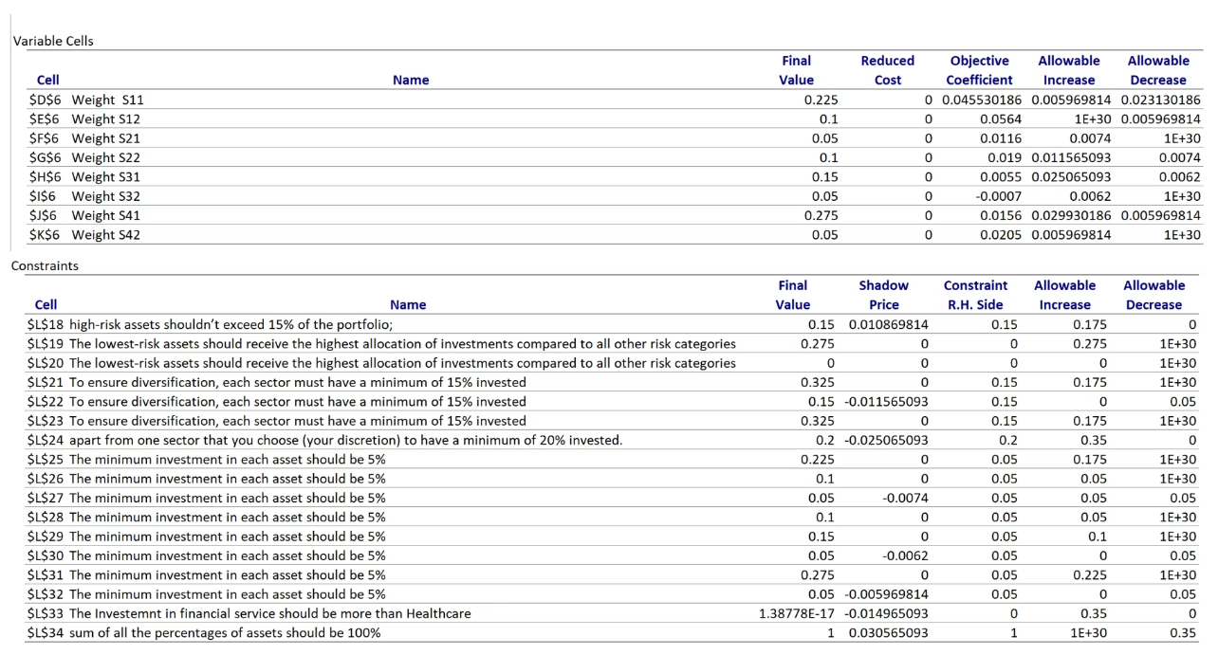
LP Model - Sensitivity Analysis (Overview)

Slide 12
LP Model - Sensitivity Analysis (Reduced Costs and Strategies)
S11 (PME) - Balanced but Sensitive
S41 (CBA) – Most Flexible High Contributor
Final Weight: 22.5%
Final Weight: 27.5%
Allowable Increase: 0.006
Allowable Increase: 2.99%
Allowable Decrease: 2.31%
Allowable Decrease: 0.60%
Return can fall to 2.24% and our optimal solution can still be held. However, even a small increase beyond 4.55% can change the optimal solution.
CBA (S41) has strong contribution to return. Its return could rise up to 4.55% (1.56 + 2.99) without changing the solution. It can drop to 0.96% before being dropped or weight changed.
S12 (Telix) – High Return but No Buffer
S21 (Xero) – Constraint-Driven, Not Return-Sensitive
Return: 5.64%
Final Weight: 5%
Allowable Decrease: Only 0.60%
Allowable Increase: 0.0074
Allowable Increase: ∞
Allowable Decrease: 1E+30
If Telix's return drops below ~5.04%, it might be excluded or its weight reduced.
Xero (S21) has a narrow allowable increase, meaning it's already at the edge of being worth including. But with an unlimited allowable decrease, it shows that no matter how much worse its return gets, it would still remain in the portfolio — indicating it's needed solely for satisfying constraints like R2 risk group or Technology sector coverage.
Conclusion
The most stable assets in the model are S11 and S41 – they tolerate return drops and still stay optimal. Assets like SEEK and ZIP are included mainly for constraint coverage, not for high return, and would likely be removed if constraints were relaxed.

Slide 13
LP Model - Sensitivity Analysis (Shadow Prices and Impacts)
Constraint
Shadow Price
Meaning
R3 max (high-risk ≤ 15%)
+0.0109
Portfolio return would increase by 1.09% for each 1% relaxation of the R3 cap – binding and limiting.
Sector S2 min 15%
-0.0116
This sector is barely meeting its minimum – relaxing it would improve flexibility.
Sector S4 min 20%
-0.0251
Very strong constraint – relaxing it would significantly improve return (2.5% per unit relaxed).
S32 minimum investment (5%)
-0.0074
SEEK (S32) included only because of the constraint – very low return, adds little value.
S34: Financials > Healthcare (custom rule)
-0.0150
This constraint forces investment shift – relaxing it would give better return options.
Total sum = 100%
+0.0306
The model is fully invested; any extra funds (hypothetically) would yield high return per 1% (3.06%).

Slide 14
LP Model - Sensitivity Analysis (Shadow Prices and Impacts)
Constraint L21: Sector S1 ≥ 15%
Final Value = 32.5%, Constraint = 15%
Surplus = 17.5%
The portfolio significantly over-invests in Healthcare (S1) compared to the required minimum.
This suggests Healthcare assets (S11 and S12) are highly valued in the portfolio (e.g., Telix has a high return), and the constraint isn't restricting anything.
Constraint L25: S11 (PME) ≥ 5%
Final Value = 22.5%, Constraint = 5%
Surplus = 17.5%
Pro Medicus (S11) is a top-performing asset in the model, far exceeding its required allocation.
Its inclusion is driven by performance, not constraint pressure — it would remain even if its minimum was removed.
Constraint L31: S42 (ZIP) ≥ 5%
Final Value = 5%, Constraint = 5%
Surplus = 0%
Constraint L26: S12 (Telix) ≥ 5%
Final Value = 10%, Constraint = 5%
Surplus = 5%
Telix's return is high enough to justify going beyond its required minimum, even though it belongs to R3 (high risk).
Despite the R3 cap, this asset makes the cut — shows strong return-to-risk tradeoff.

Slide 15

Integer Linear Programming Model
Moving beyond continuous allocations to discrete investment decisions with binary variables.

Slide 16
ILP Model – Algebraic Formulation
Objective Function
Maximise portfolio return by selecting 5 out of 8 assets:
Max Z=0.04553xS11+0.0564xS12+0.0116xS21+0.019xS22+0.0055xS31−0.0007xS32+0.0156xS41+0.0205xS42
Constraints Overview
Asset Selection Requirements
CST 1: Exactly 5 assets must be selected
x1+x2+x3+x4+x5+x6+x7+x8=5
Sector Representation
CST 2: All 4 sectors must be represented
Healthcare: x1+x2≥1
Technology: x3+x4≥1
Communication: x5+x6≥1
Financials: x7+x8≥1
Risk Management Constraints
CST 3: At most 1 asset from high-risk group (R3)
R3 assets: x2, x8 x2+x8≤1
CST 4: At least 2 assets from low-risk group (R1)
R1 assets: x5, x7 x5+x7≥2
Risk Balance Requirements
CST 5: Only allow R3 if R2 is selected
x1+x3+x4+x6-x2-x8 ≥0
CST 6: at least one stock from R1
x5+x7 ≥0
CST 7: at least one stock from R2
x1+x3+x4+x6 ≥0

Slide 17
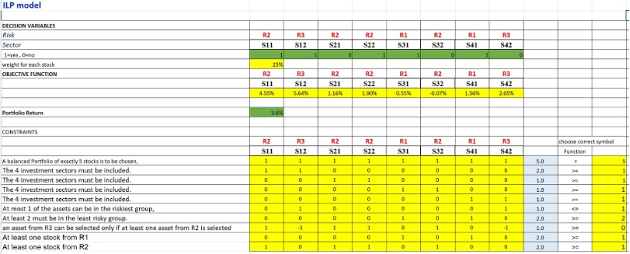
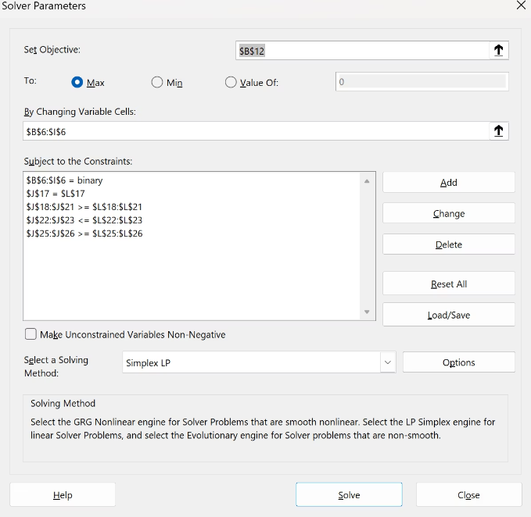
ILP Solver Setup (Excel)
Solver was configured using the Simplex LP method with binary constraints applied to all decision variables.
The objective was to maximise total return by selecting the best 5 assets while satisfying sector, risk, and custom constraints.
All constraints were added as shown in the formulation slide

Slide 18
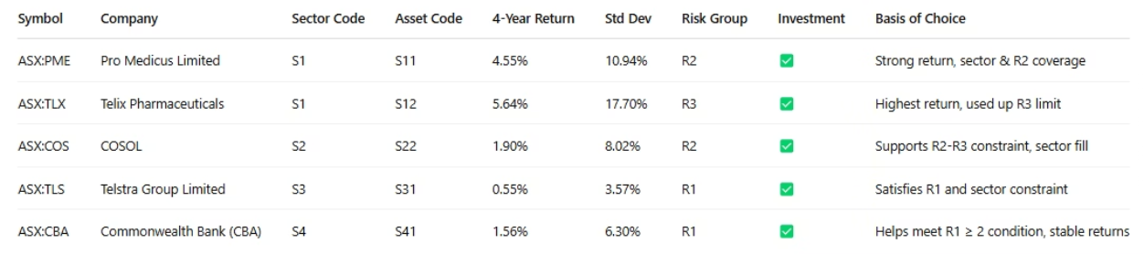
ILP Results – Selected Portfolio (5 Assets)
📌 Total Portfolio Return: 3.6%
✅ Constraints Satisfied:
Exactly 5 assets selected
All 4 sectors represented
Only 1 R3 asset (S12)
At least 2 R1 assets (S31 & S41)
R3 selected only because R2 assets (S11 & S22) are included
No more than 2 assets from any sector
The ILP model selected a balanced yet high-performing portfolio that includes two assets from Healthcare (S1), showing its strong return profile.
The inclusion of a high-risk asset (Telix, S12) was justified by its outstanding return, balanced by low-risk picks like CBA (S41) and Telstra (S31).
The model ensures a mix of risk levels while maximising return under strict selection rules.

Slide 19
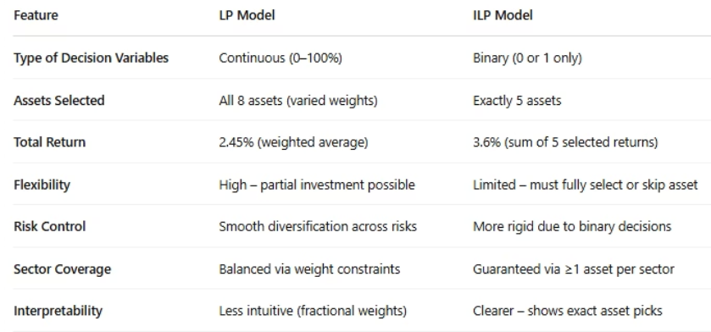
Comparison & Recommendation
After running both Linear Programming (LP) and Integer Linear Programming (ILP) models, we recommend proceeding with the LP-based investment strategy.
Why LP over ILP:
LP offers greater flexibility by allowing partial investments in all 8 assets, which leads to better diversification across sectors and risk groups.
It limits overexposure to any single asset or sector and aligns better with long-term, risk-managed portfolio growth.
ILP provides higher short-term return (3.6%) but sacrifices diversification and includes high-risk picks that may not align with the company's long-term strategy.
Action Plan:
Use the LP model as your core portfolio strategy.
It balances return with stability, meets all investment constraints, and reduces risk exposure without sacrificing sector representation.

